Slide 1
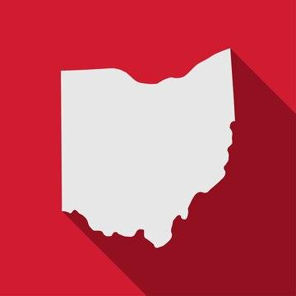
Chasing Tornadoes in the Buckeye State
Lacilynn Graham

Slide 2
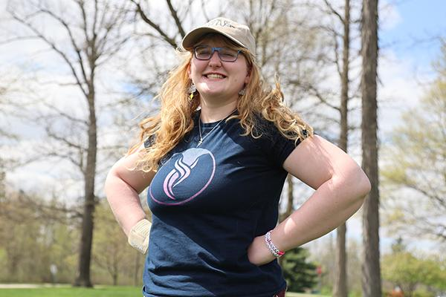
About Me
I'm 20 & a student at The Ohio State University
EMT
I've been a storm chaser for 5 years, and a weather enthusiast for 17
President of Ohio State Lima's Earth Science Club
Helped to update SKYWARN in Allen County Ohio
Speaker
WX8NRD

Slide 3
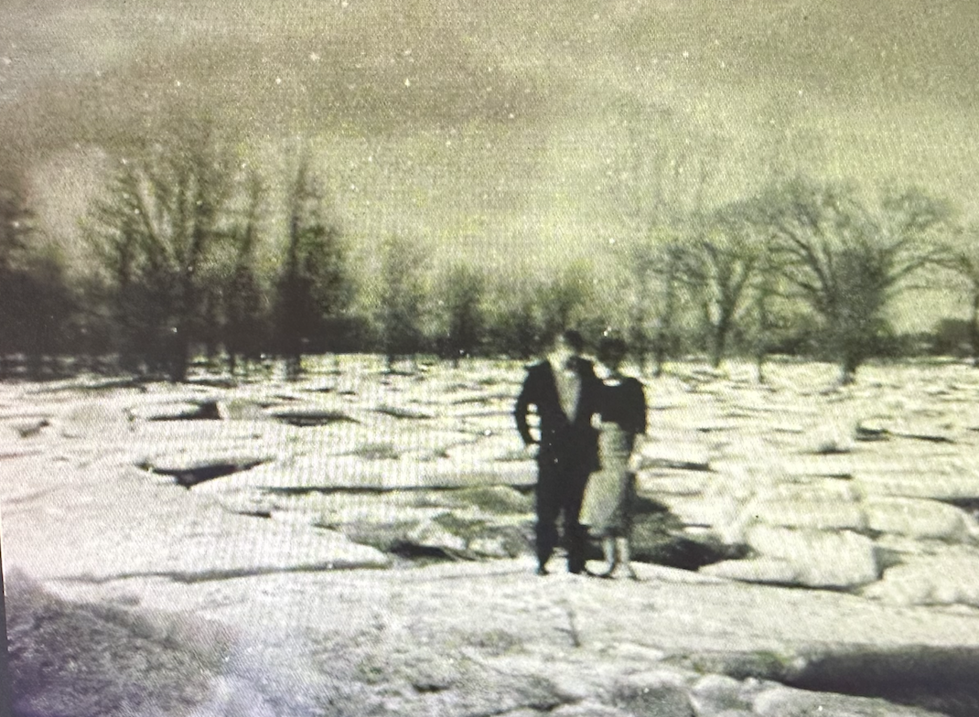
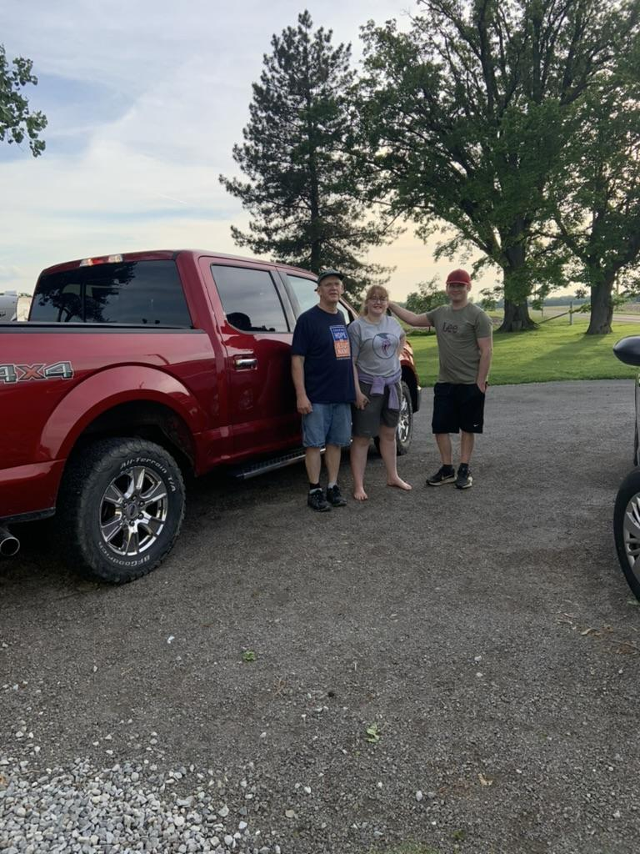
Storm Chasing Runs in the Family

Slide 4
Best Place to Find a Tornado in Ohio?

Slide 5
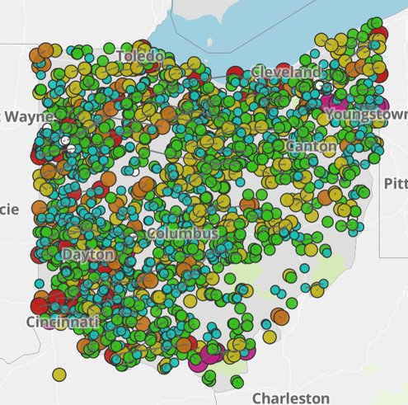
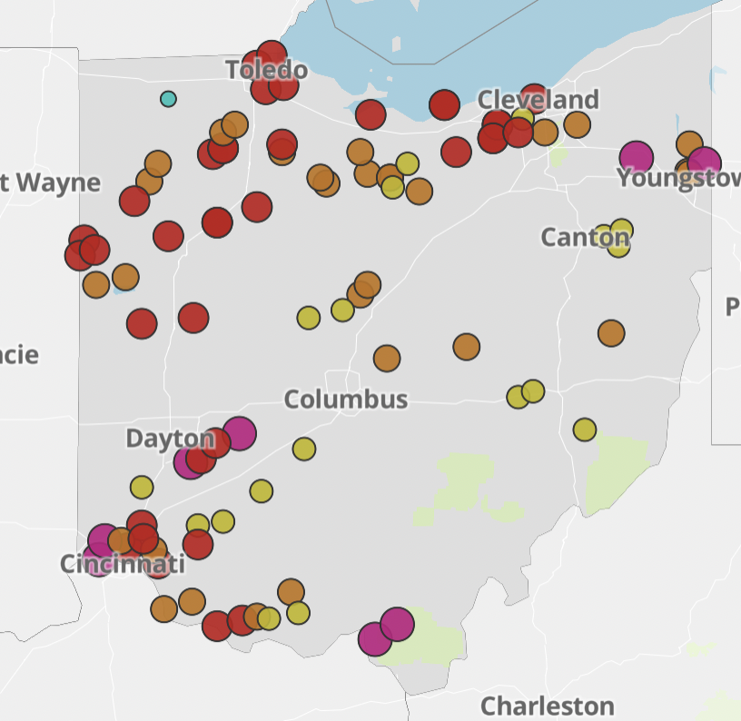
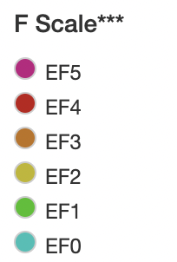
Ohio Tornado Misconception
Tornadoes in Ohio since 1950
https://data.cincinnati.com/tornado-archive/
Deadly Tornadoes in Ohio since 1950
https://data.cincinnati.com/tornado-archive/

Slide 6
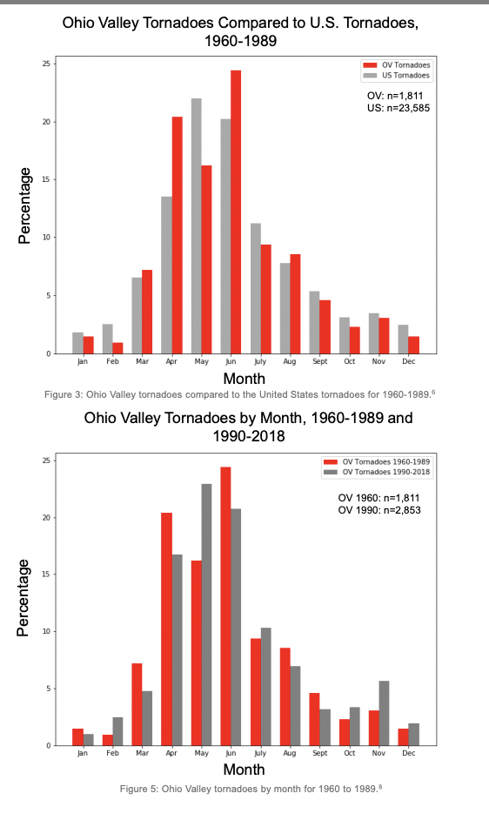
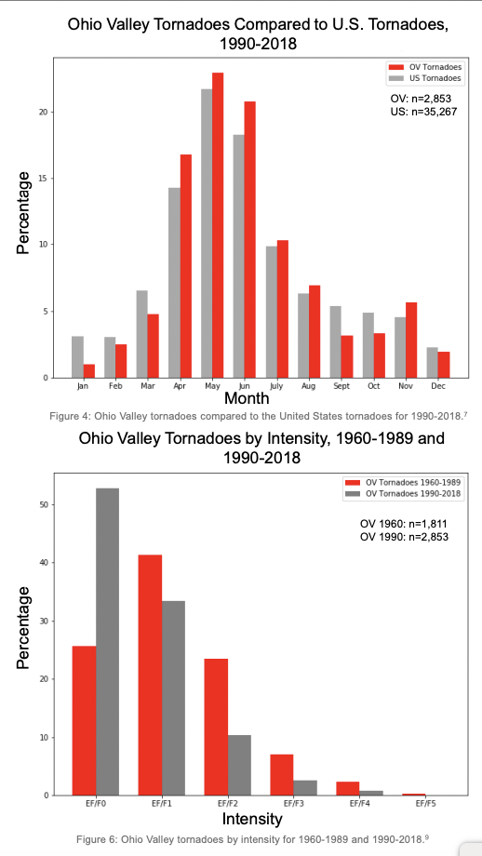
Ohio Tornado Climatology

Slide 7
Ohio Tornado Climatology

Slide 8
Ohio Mythology with Tornadoes
The Land of the Devil Winds
The Shawnee Tribe called the Miami Valley the "Land of the Devil Winds" and told settlers not to build there.
Land Protected by a Blessing from a Chief
There's a legend that an old Shawnee Chief blessed the land around Fort Shawnee Ohio.

Slide 9
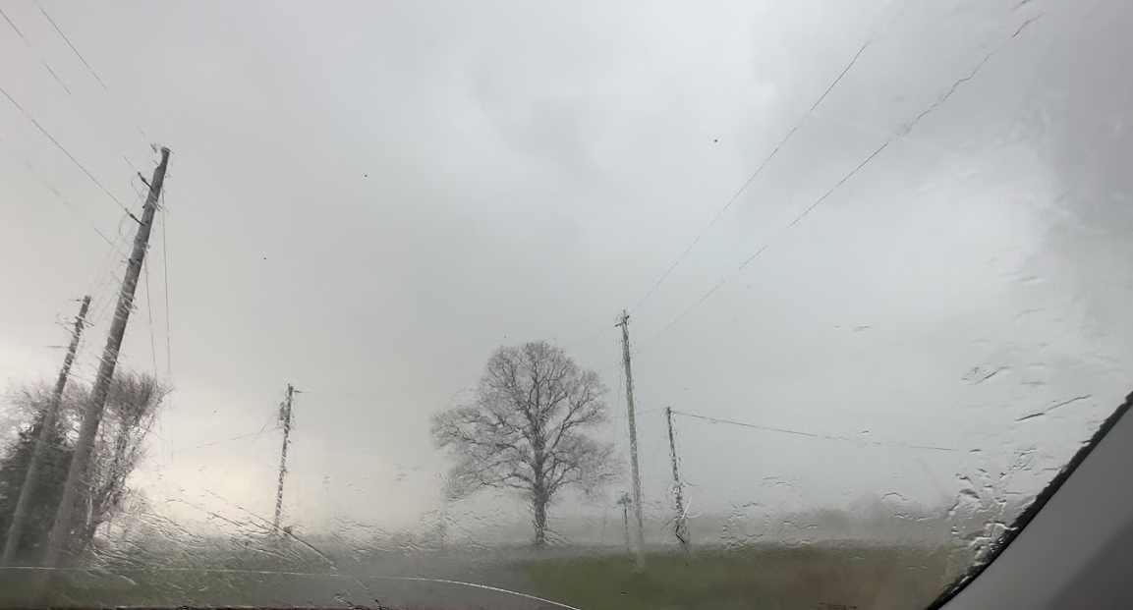
Difficulties Chasing/Spotting in Ohio
Fast Moving Storms
Short Lived Storms
Not Always Clear Structure
A Lot QLCS
Edges of Radar

Slide 10
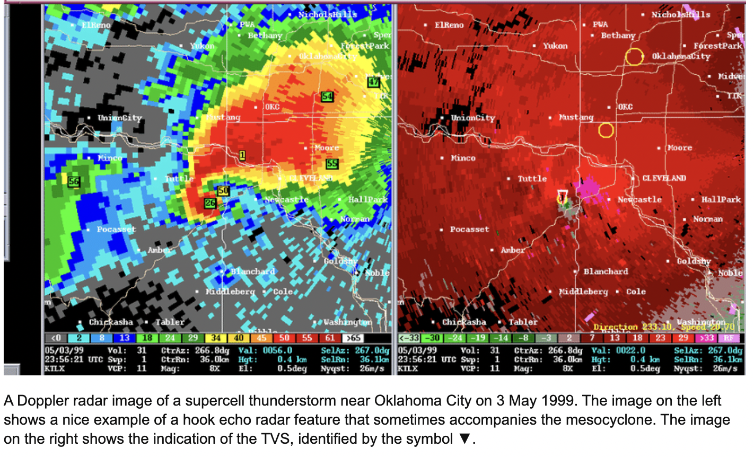
Supercell vs QLCS Tornadoes

Slide 11
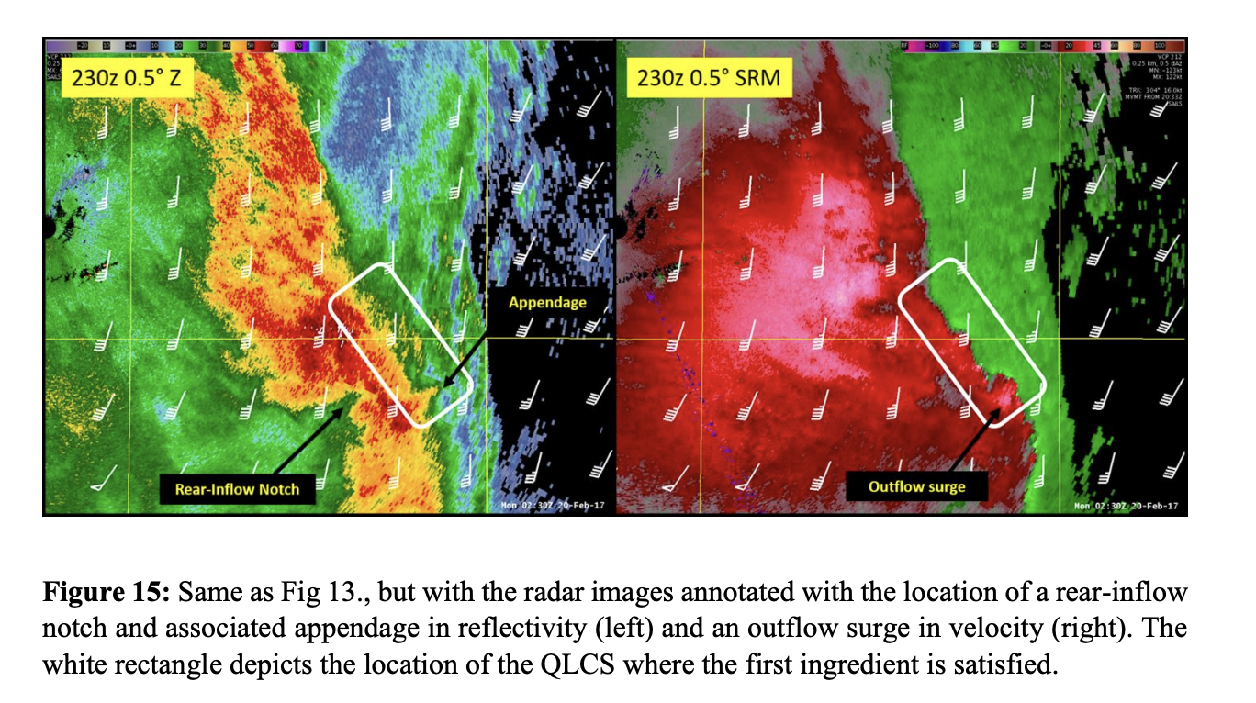
Supercell vs QLCS Tornadoes

Slide 12
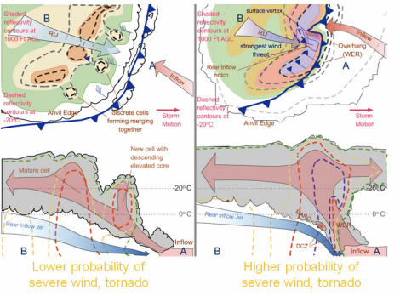
3-D QLCS Structure
National Weather Service

Slide 13
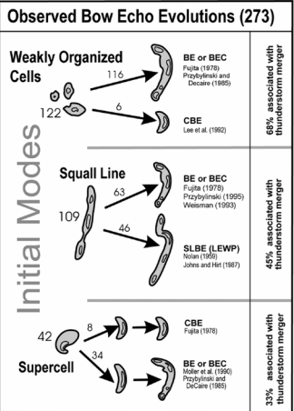
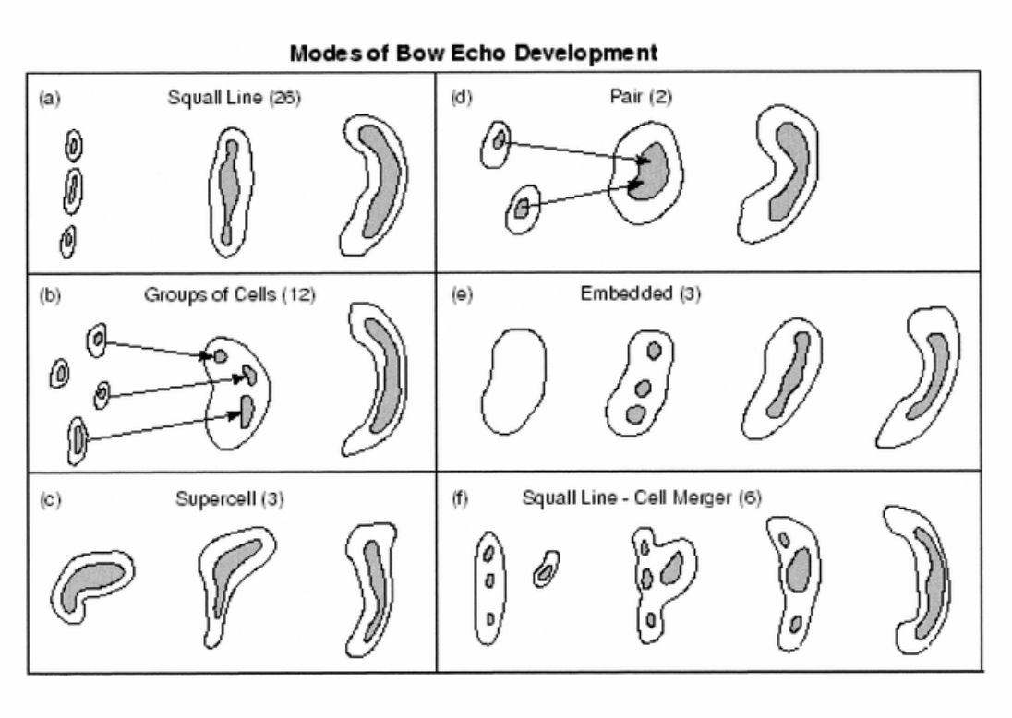
Initial Convective Modes for Leading to Bow Echos
National Weather Service

Slide 14
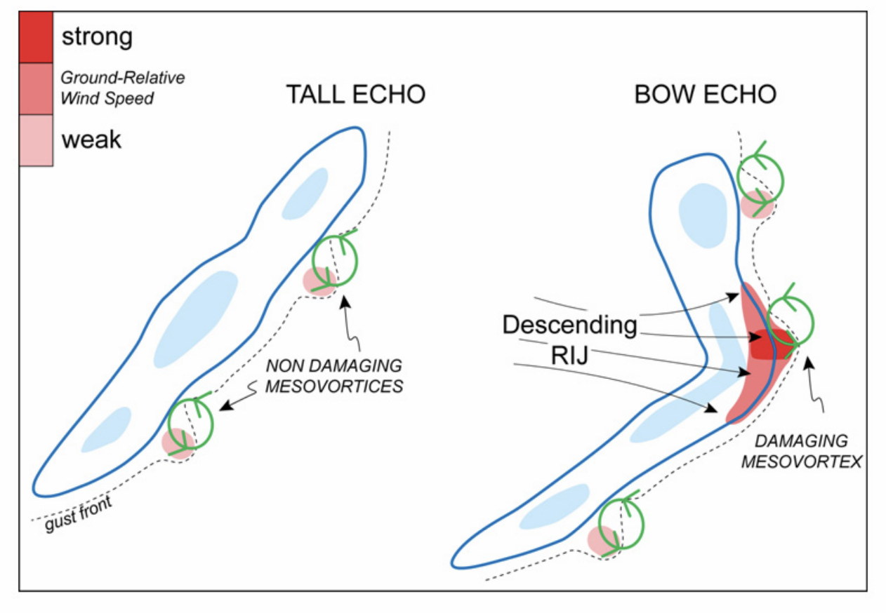
Initial Stage of a Damaging Bow Echo
National Weather Service

Slide 15
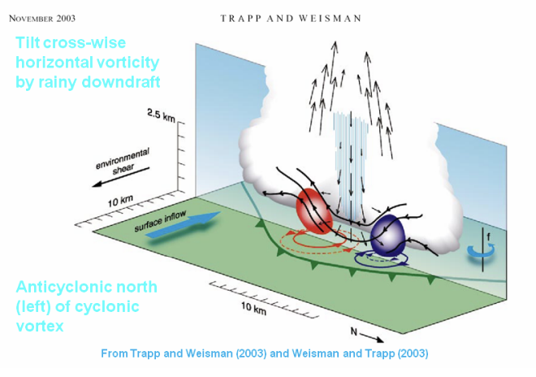
Mesovortex Formation: Downdraft Tilts

Slide 16
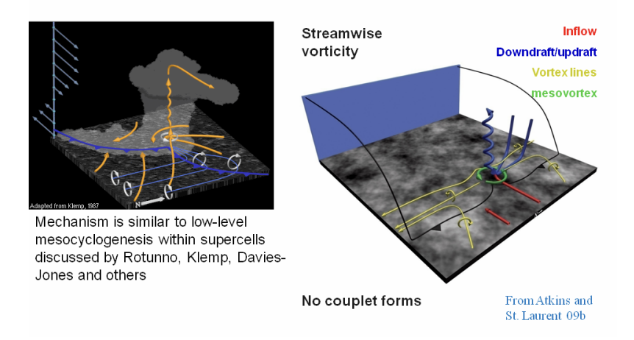
Mesovortex Formation: Local Updrafts Tilts

Slide 17
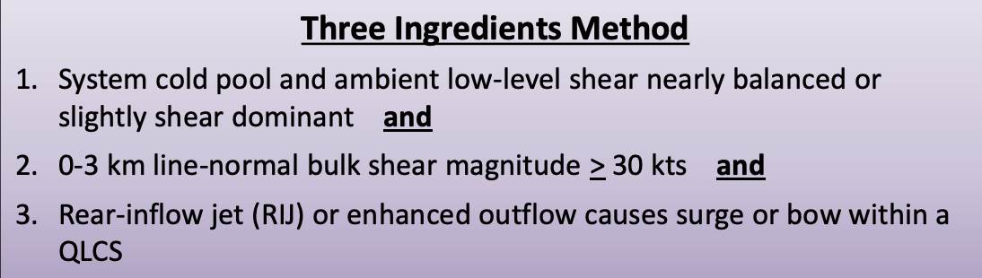
Warning QLCS

Slide 18
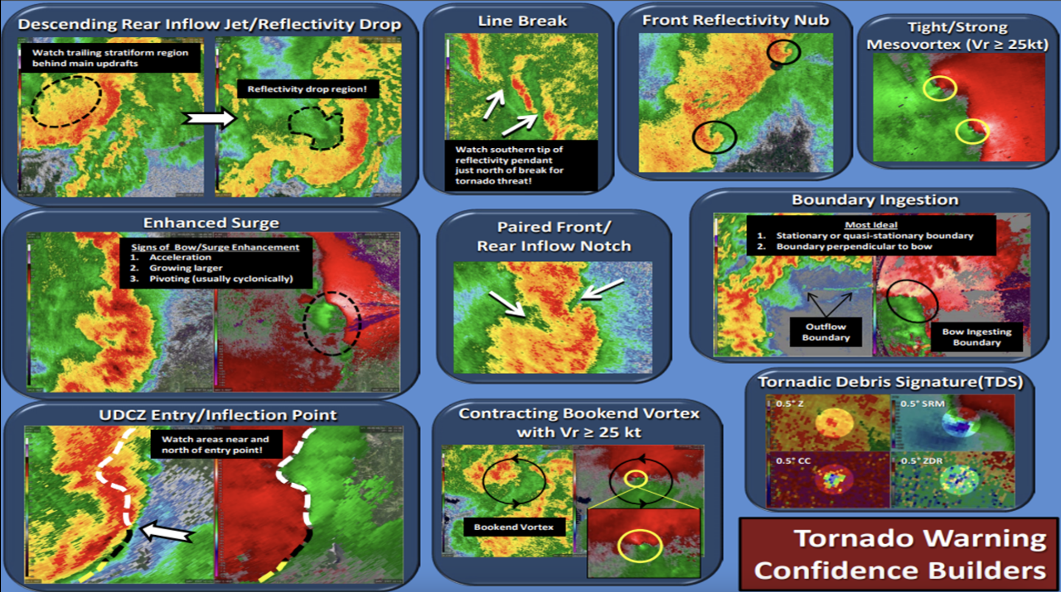

Slide 19
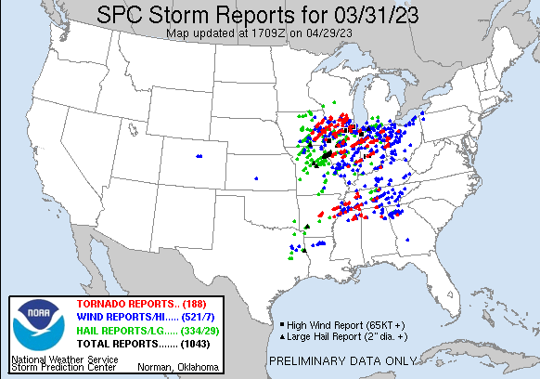
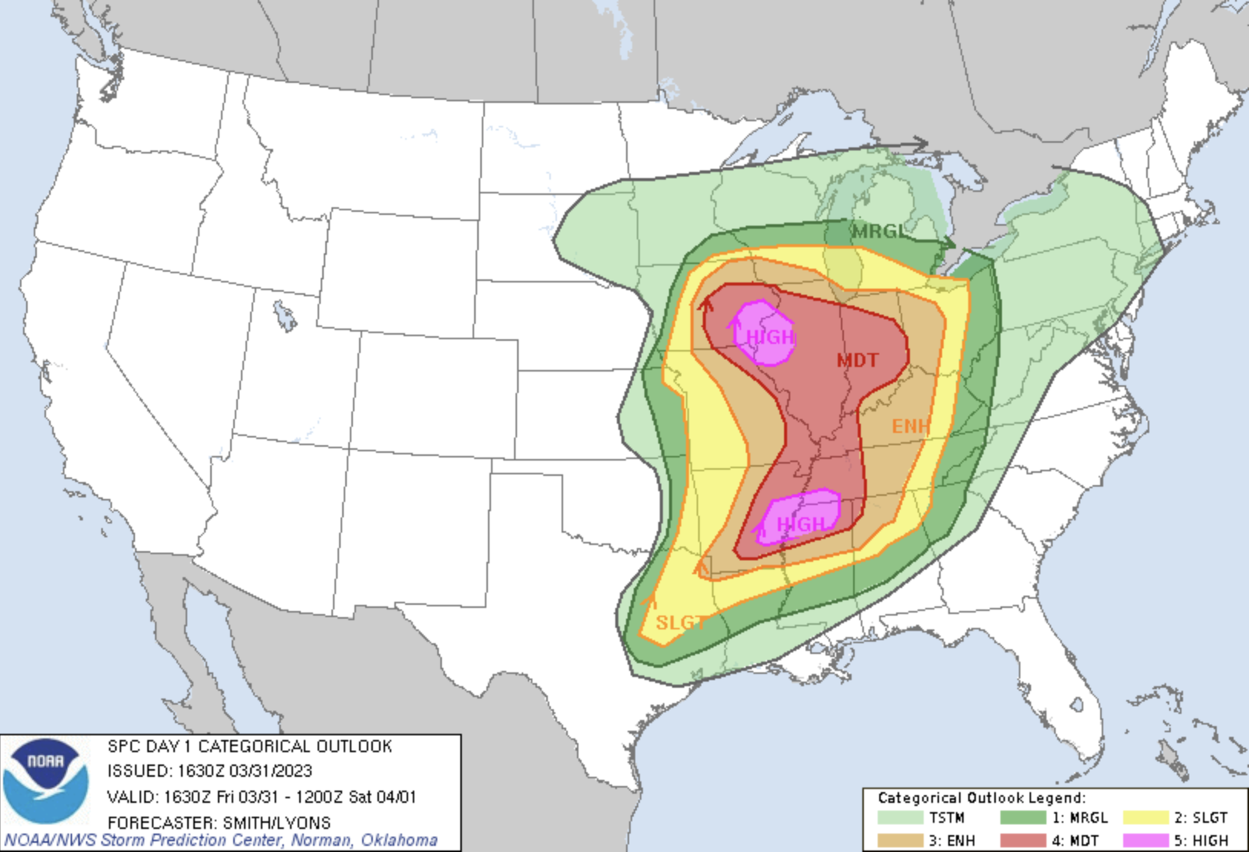
March 31 – April 1, 2023 Outbreak
2nd largest tornado outbreak in history (NWS)
147 tornadoes touched down
SPC Nailed It!

Slide 20
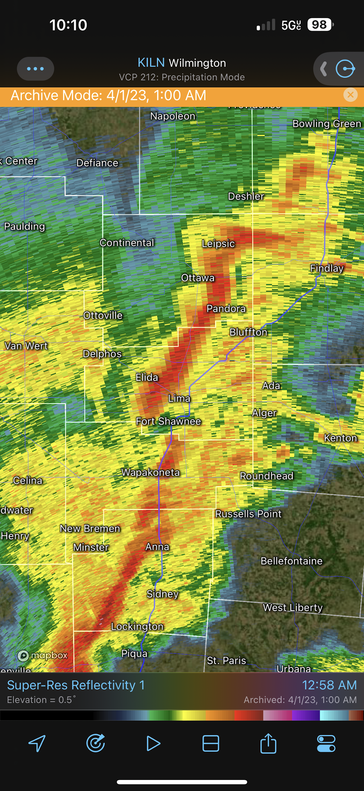
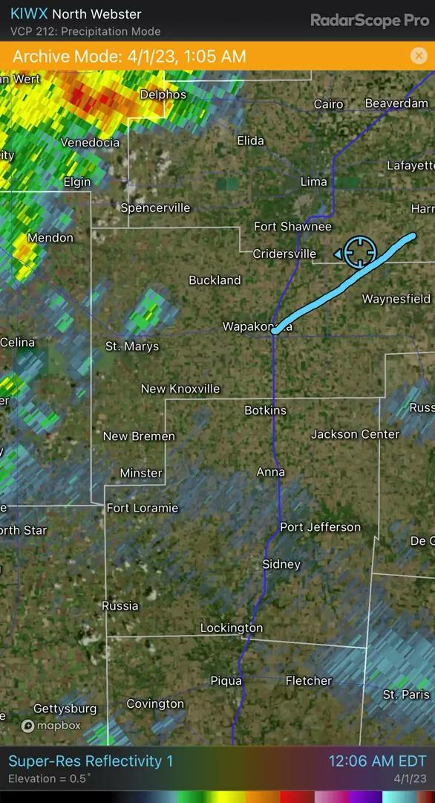
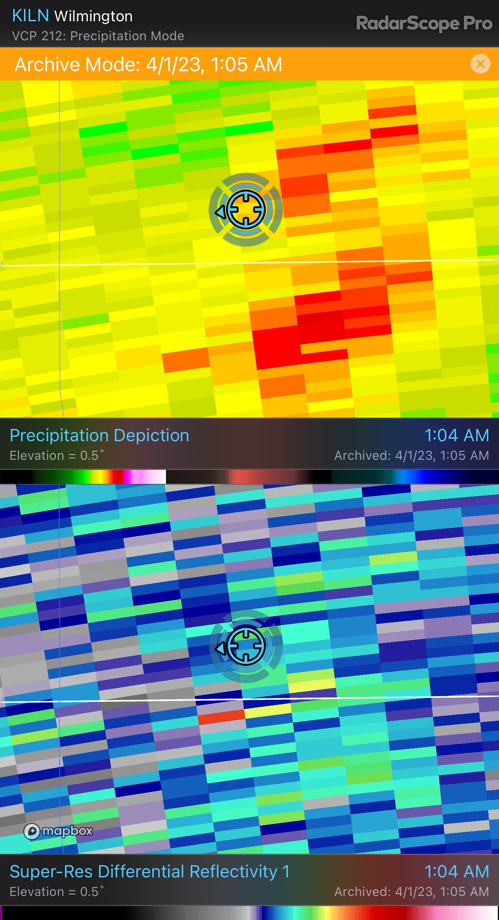
Can You See the Tornado?

Slide 21
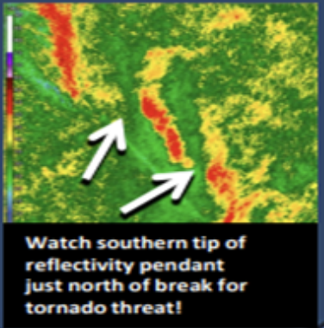
March 31 – April 1, 2023 Outbreak
Line Break

Slide 22
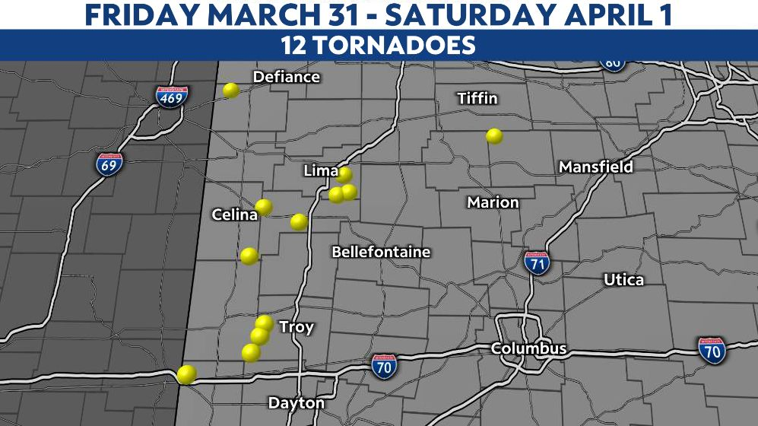
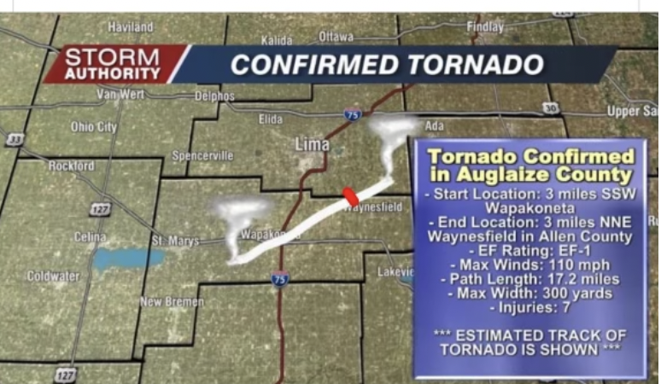
March 31 – April 1, 2023 Outbreak

Slide 23
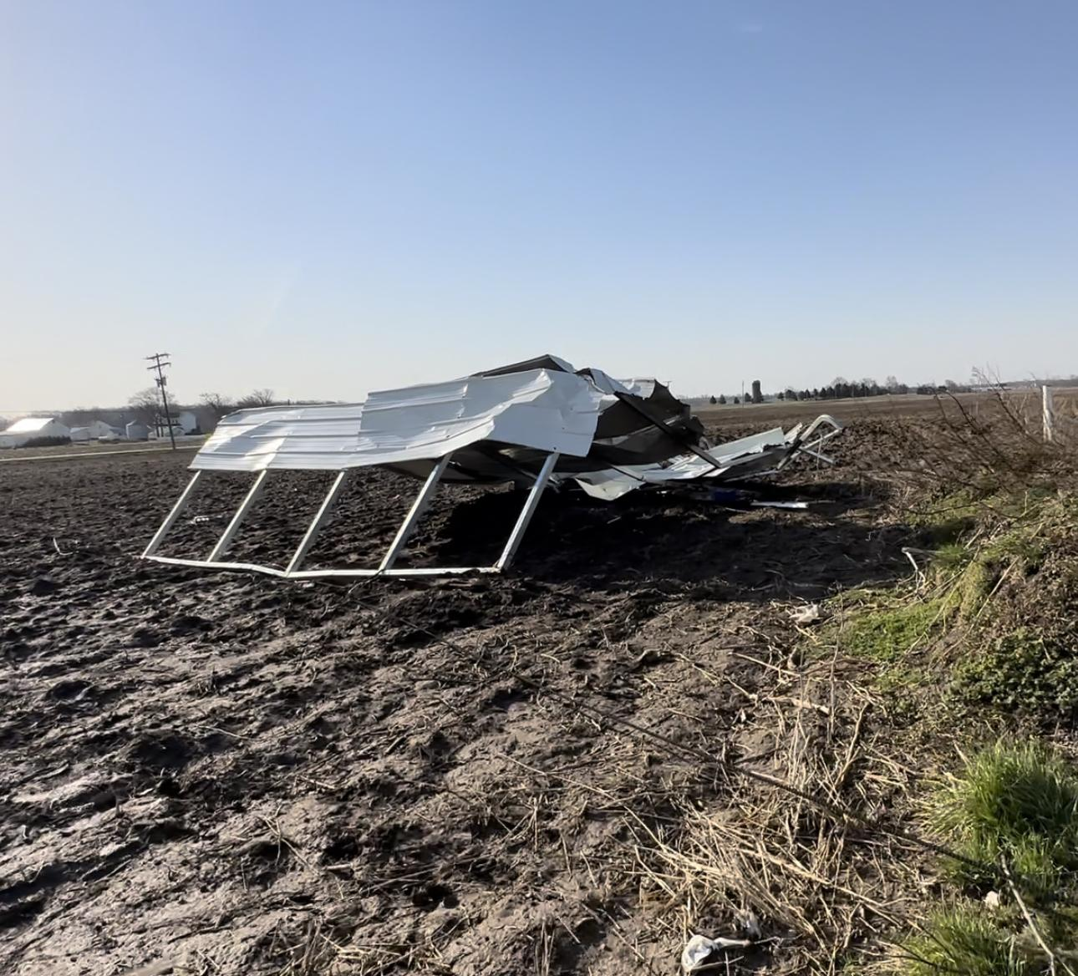
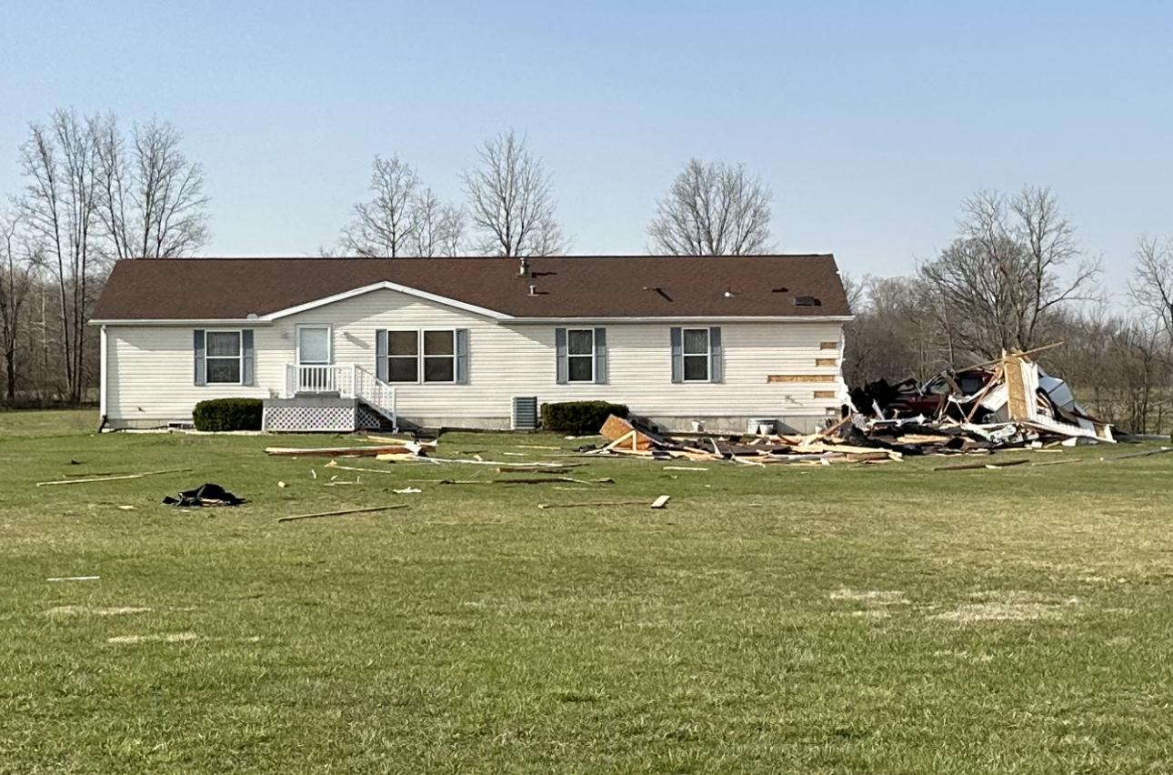
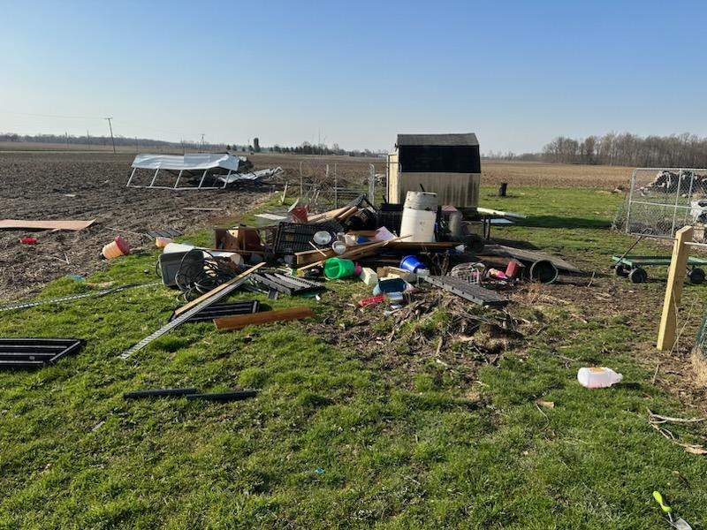
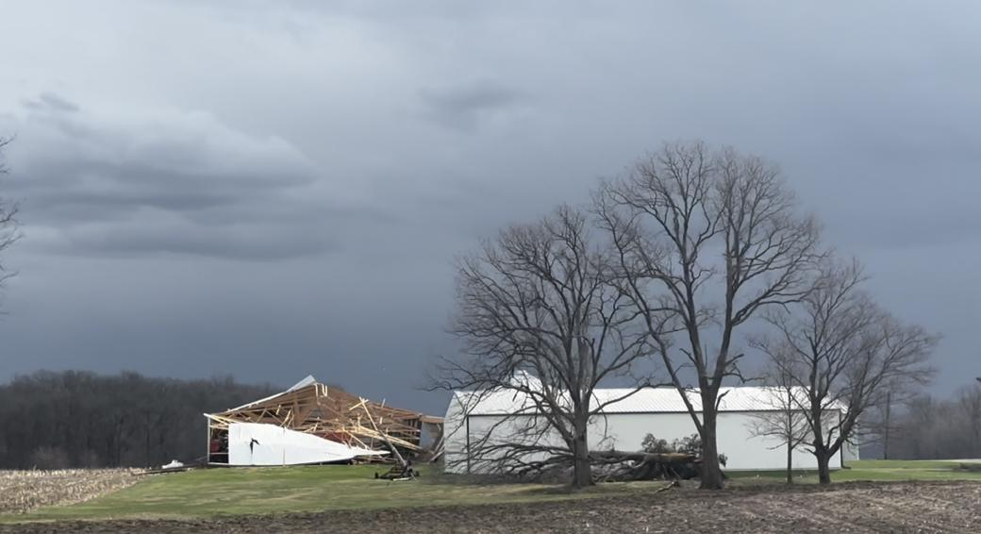
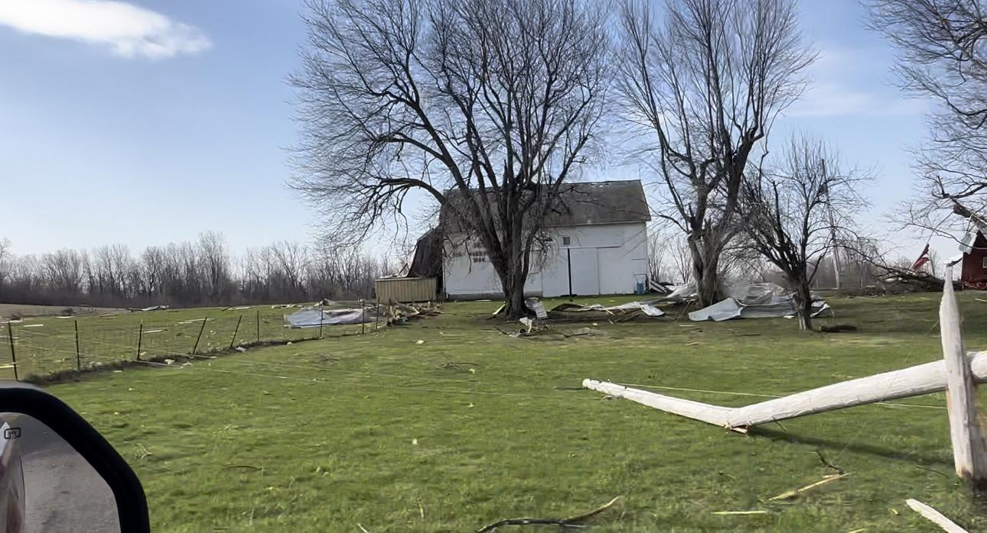
Even Low Rated Tornadoes Impact People

Slide 24
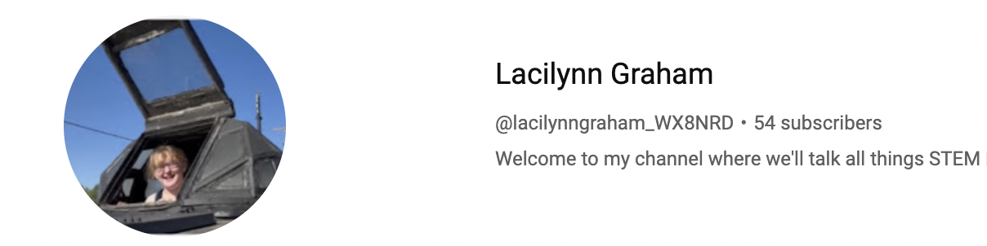
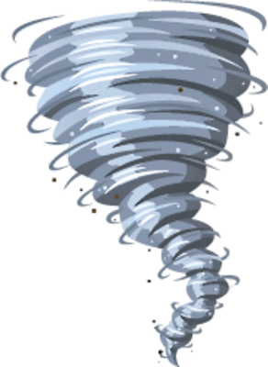




WX8NRD
Lacilynn Graham
_weather_nerd_
theeweathernerd

